Slide 1
Photochemical Rearrangements.
Photo-Fries Rearrangement :
Magauer, T.; Martin, H.J.; Mulzer, J. Angew. Chem. Int. Ed. 2009, 48, 6032-6036

Slide 2
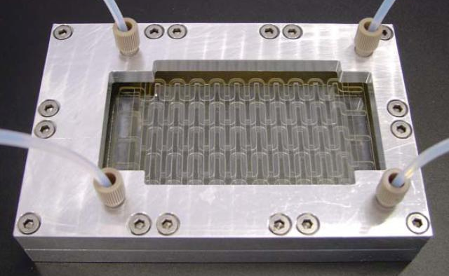
Conclusion.
Equipment
Use of continuous flow reactor
Possibilities to scale-up reaction
Photochemical reaction
Light as the only reactant
Control in the product generated
Access to important fragment from simple molecules

Slide 3

Why VISIBLE Light PhotoredoX Catalysis?
Visible Light (43% of Solar Energy): available, clean and renewable.
Readily
An attractive “reagent” for organic synthesis
• Potential byproducts are minimized
Atom economical
Mild alternative to traditional methods
Environmentally friendly
Problem: Many organic molecules are unable to absorb visible light requiring highly specialized energy sources for traditional UV photochemistry
Solution: Photoredox catalysis (use of catalysts that can absorb visible light and then trigger reactions)
For an early discussion of visible light in photochemical reactions see Ciamician, G. Science 1912, 36, 385–394.
⁺Teply, F. Collect. Czech. Chem. Commun. 2011, 76, 859.
Narayanam, J. M. R.; Stephenson, C. R. J. Chem. Soc. Rev. 2011, 40, 102.

Slide 4
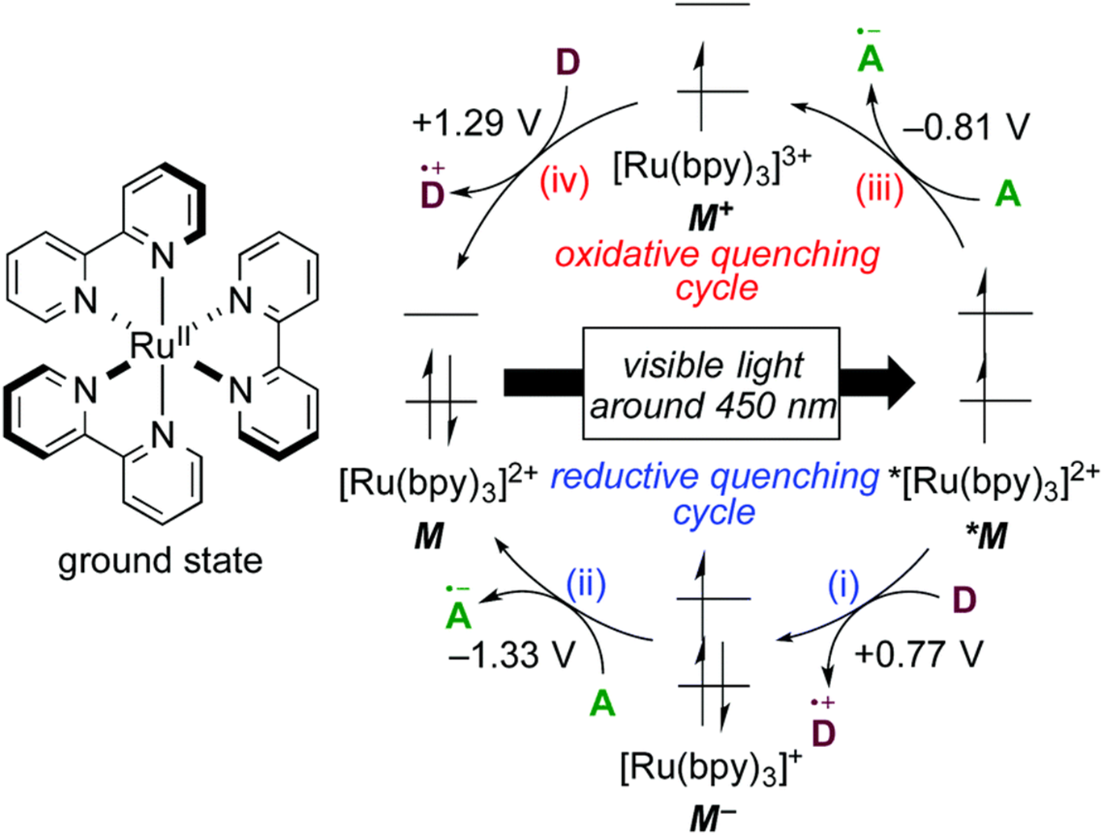
Basics of Photoredox Catalysis
The excited state Ru species can be converted to either a strong oxidant (Ru+3 species) or to a strong reductant species (Ru+1) by using appropriate quenching agents as shown.
S = substrate (reactant)
Ar-NO
Viologens _{Fe}3+
_{S2O8}2-
Ru⁺³ is a strong oxidant. This cycle is employed for triggering reactivity from electron-rich substrates
S
A = reagents that will take an electron from the excited state Ru species such as the oxidants above
S
Et₃N (CO₂)²⁻
Xanthate Ascorbate
(catalyst)
S
D = reagents that will take an electron from the excited state Ru species such as the reductants above
Ru⁺¹ is a strong reductant. This cycle is employed for triggering reactivity from electron-poor substrates
S

Slide 5


History of Photoredox Catalysis
Kellogg
O
O
EtOOC
COOEt
[Ru(bpy)₃]Cl₂
1 mol%
S
BF₄–
Ph
+
+
Ph
_{S}+
N
CD₃CN
25 ºC, room light
0.3 h
quantatitive
1978
1984
2003
2008
Hedstrand D. M., Kruizinga W. H., Kellogg R. M. Tetrahedron Lett. 1978, 19, 1255.

Slide 6

History of Photoredox Catalysis
Kellogg
O
O
EtOOC
COOEt
[Ru(bpy)₃]Cl₂
1 mol%
S
BF₄–
Ph
+
+
Ph
_{S}+
N
CD₃CN
25 ºC, room light
0.3 h
quantatitive
1978
1984
2003
2008
COOH
hν λ > 410 nm [Ru(bpy)₃]Cl₂ 5 mol%
COOH
Deronzier
_{N2}+
BF₄–
CH CN
3
R
R
R= H, Br or OMe
quantatitive
Cano-Yelo H., Deronzier A. J. Chem. Soc., Perkin Trans. 2 1984, 1093.

Slide 7


History of Photoredox Catalysis
Zen
visible light 500W halogen lamp
NPyc^{x}-Ru(bpy)
O
S
SMe
R = H
R = COMe
>97%
96%
MeCN-H₂O 3:4 O₂, pH = 1
3 h
Kellogg
Reduction Chemistry
R
R
1978
1984
2003
2008
COOH
hν λ > 410 nm [Ru(bpy)₃]Cl₂ 5 mol%
COOH
Deronzier
_{N2}+
BF₄–
CH CN
3
R
R
R= H, Br or OMe
quantatitive
Zen J. M., Liou S. L., Kumar A. S., Hsia M. S. Angew. Chem. Int. Ed. 2003, 42, 577

Slide 8
History of Photoredox Catalysis
Zen
visible light 500W halogen lamp
NPyc^{x}-Ru(bpy)
O
S
SMe
R = H
R = COMe
>97%
96%
MeCN-H₂O 3:4 O₂, pH = 1
3 h
Kellogg
Reduction Chemistry
R
R
1978
1984
2003
2008
Yoon
O
O
[Ru(bpy)₃]Cl₂
5 mol%
O
O
H
H
Ph
Ph
MeCN, ^{i}Pr₂NEt
Ph
Ph
LiBF₄, visible light
H
H
intramolecular
89%, >10:1 dr
Ischay M. A., Anzovino M. E., Du J., Yoon T. P. J. Am. Chem. Soc. 2008, 130, 12886.

Slide 9
Oxidative Aza-Henry Reaction
R
1
[Ir(ppy)₂bpy]PF₆ (1 mol%)
R
1
_{R}2
N
_{R}2
N
3
3
R
R⁴CH₂NO₂
visible light 10-18 h
R
O₂N
_{R}4
R₂
R₂
N R₁
N H
2 R₁
N R₂
3 R₁
1
Ir(III)*
Photoredox cycle
Ir(III)
Ir(II)
HO O
O₂
O N
O
4
household light bulb
O₂
NO₂
N R₂ R₁
5
Condie A. G., González-Gómez J. C., Stephenson C. R. J. J. Am. Chem. Soc. 2010, 132, 1464.

Slide 10
Oxidative Strecker Reaction
[Ir(ppy)₂bpy]PF₆ ( 1 mol%)
KCN (1.2 equiv), AcOH (5 equiv), MeCN
N
5 W fluorescent bulb, O₂
N
Ph
Ph
CN
N
N
N
N
CN
CN
Me
CN
OMe
CN
Br
97%
97%
84%
82%
Me
N
N
N
CN
CN
CN
Ph
76%
88%
79%
Rueping, M.; Zhu, S.; Koenigs, R. M. Chem. Commun. 2011, 47, 8679

Slide 11
Proposed Mechanism
[Ir(ppy)₂bpy]PF₆ ( 1 mol%)
KCN (1.2 equiv), AcOH (5 equiv), MeCN
N
5 W fluorescent bulb, O₂
N
Ph
Ph
CN
R
1,2-H shift
R N
Ar'
_{N} +
Ar
+
H
Ar
Ar'
–H⁺
–H⁺
–H
–e–
R
R
–
R
Ar'
_{N} +
Ar
Ar'
N
–e
Ar'
_{N} +
Ar
Ar
Rueping, M.; Zhu, S.; Koenigs, R. M. Chem. Commun. 2011, 47, 8679

